Slide 1

Heart Stroke Analysis Utilizing Machine Learning for Early Detection
By: Rubel Binu and Aniket Tiwari

Slide 2

Goal
Objective
To predict the likelihood of a heart attack based on various medical attributes and risk factors.
Motivation
Heart disease is a leading global cause of death.
Early detection and intervention can significantly reduce mortality rates.
Predictive models can assist healthcare professionals in identifying individuals at higher risk, enabling proactive measures.

Slide 3

Steps
Getting Data
Preparing Data
Outlier Detection
Exploratory Data Analysis (EDA)
Data Encoding
Data Standardizing
Model Building
Model Evaluation

Slide 4

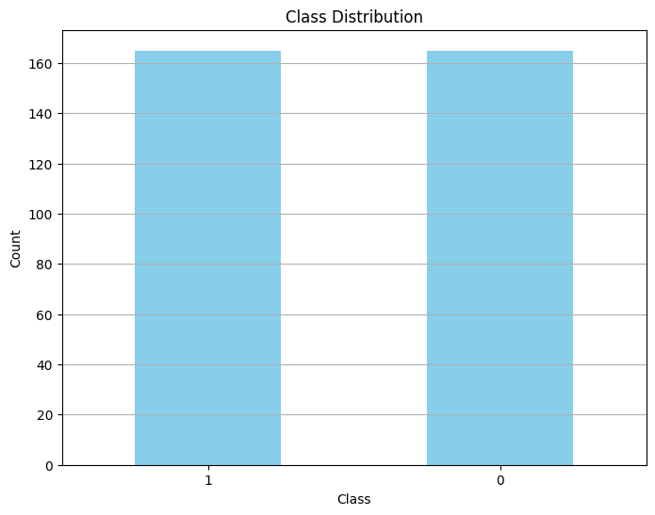
Dataset
Data Source: Kaggle
The dataset has been balanced using RandomOverSampler to ensure fair representation of target classes.
Clipping Outliers in Numerical Columns with threshold for z-score set to 3.

Slide 5
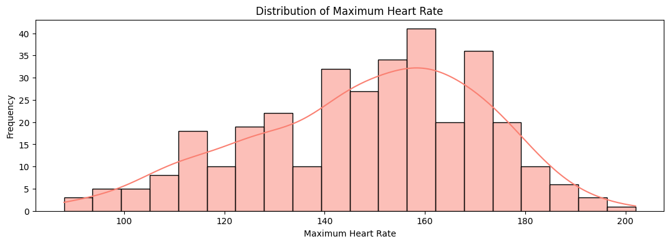
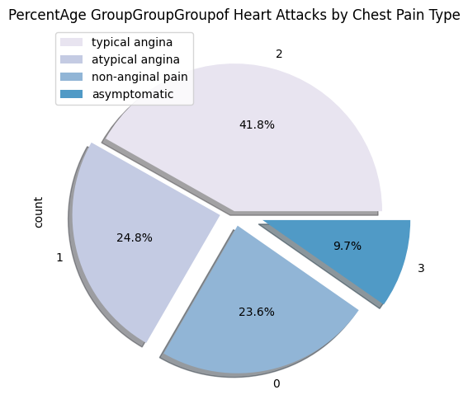
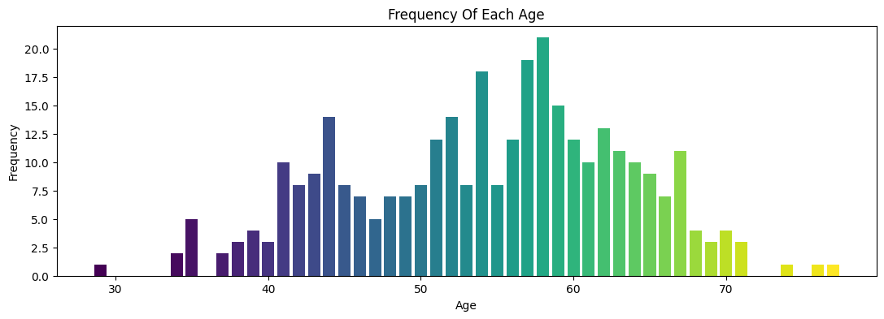
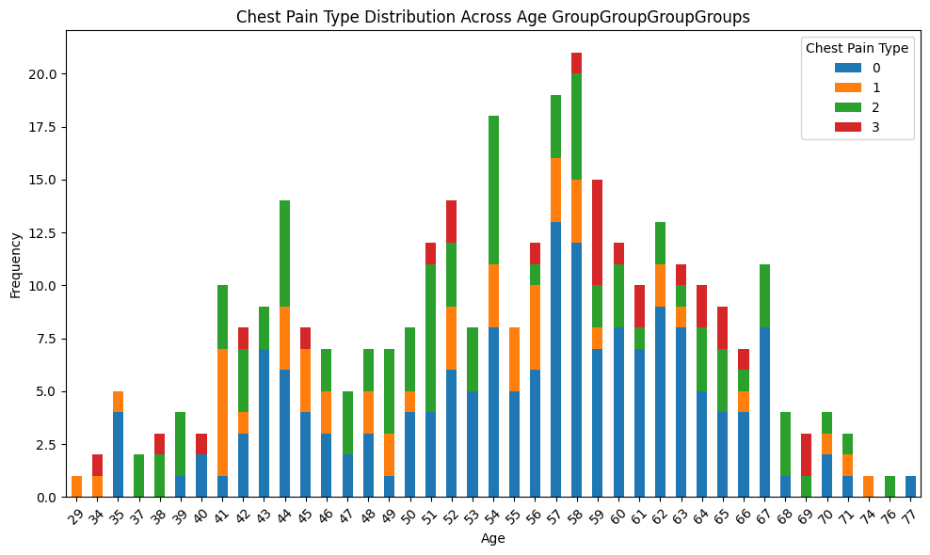
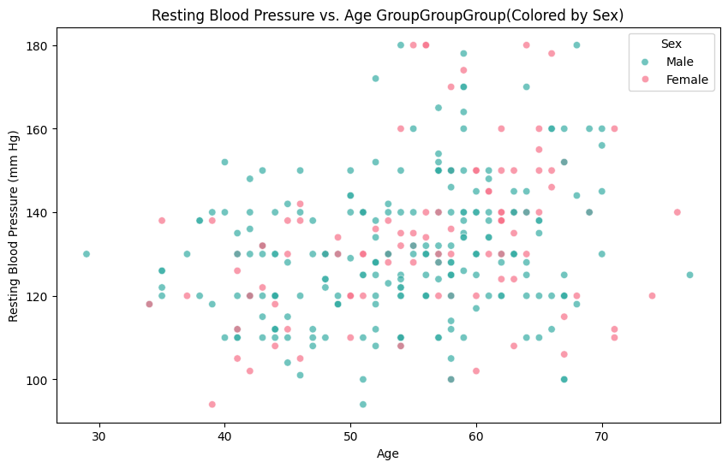
Exploratory Data Analysis (EDA)
Frequency Distribution of Age in the Dataset
The tallest bar, around age 50–55, indicates the most common age group in the dataset.
Resting Blood Pressure Trends Across Age and Sex
There is variability in resting blood pressure across different ages for both sexes.
Chest pain type (cp) across different age groups
Chest pain type 2 (green) is most prevalent among individuals in their 50s and 60s.
Distribution of Maximum Heart Rate
The bell-shaped curve (line graph) suggests a normal distribution of the data points.
Heart Attacks Distribution by Chest Pain Type
The pie chart shows that asymptomatic individuals constitute the largest group during heart attacks, followed by those with non-anginal pain, atypical angina, and typical angina.

Slide 6

Models
Logistic Regression: Classic approach for binary classification tasks.
Decision Tree: Non-linear model that splits data into branches for decision-making.
Random Forest: Ensemble of decision trees, improving prediction accuracy and robustness.
SVM (Support Vector Machine): Effective in high-dimensional spaces and for cases where the number of dimensions exceeds the number of samples.
KNN (K-Nearest Neighbors): Classifies samples based on the majority vote of their nearest neighbors.
Naive Bayes: Applies Bayes' theorem with the assumption of independence between features.
Gradient Boosting Classifier: Boosting technique that builds on weak learners to create a strong classifier.
AdaBoost Classifier: Another boosting model, focuses on misclassified instances to improve model accuracy.
XGBClassifier: Implementation of gradient boosting framework providing fast execution speed and model performance.

Slide 7
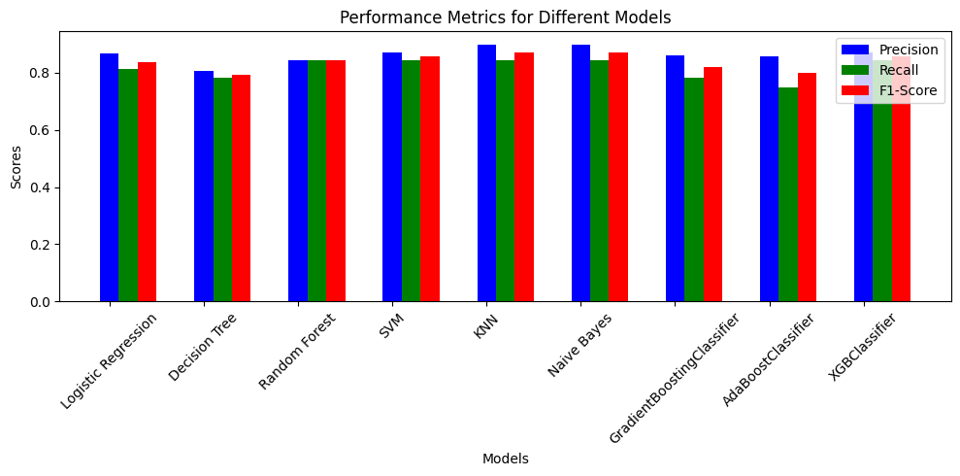
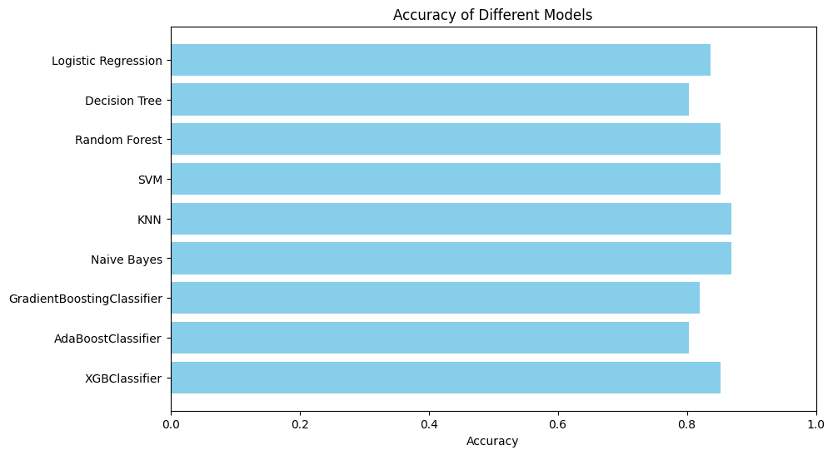
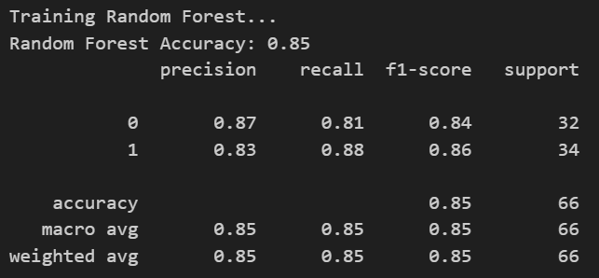
Model Selection
The Random Forest model's consistent performance across multiple evaluation metrics indicates robustness and reliability in predicting heart attacks based on the dataset used.

Slide 8
Metric Comparison
Model | Accuracy | Precision(0) | Precision(1) | Recall (0) | Recall (1) | F1-score (0) | F1-score (1)
Logistic Regression | 0.80 | 0.77 | 0.84 | 0.84 | 0.76 | 0.81 | 0.80
Decision Tree | 0.73 | 0.73 | 0.72 | 0.69 | 0.76 | 0.71 | 0.74
Random Forest | 0.83 | 0.84 | 0.83 | 0.81 | 0.85 | 0.83 | 0.84
SVM | 0.80 | 0.85 | 0.77 | 0.72 | 0.88 | 0.78 | 0.82
KNN | 0.77 | 0.79 | 0.76 | 0.72 | 0.82 | 0.75 | 0.79
Naive Bayes | 0.82 | 0.86 | 0.79 | 0.75 | 0.88 | 0.80 | 0.83
Gradient Boosting Classifier | 0.82 | 0.81 | 0.82 | 0.81 | 0.82 | 0.81 | 0.82
AdaBoost Classifier | 0.80 | 0.79 | 0.82 | 0.81 | 0.79 | 0.80 | 0.81
XGB Classifier | 0.77 | 0.76 | 0.79 | 0.78 | 0.76 | 0.77 | 0.78

Slide 9
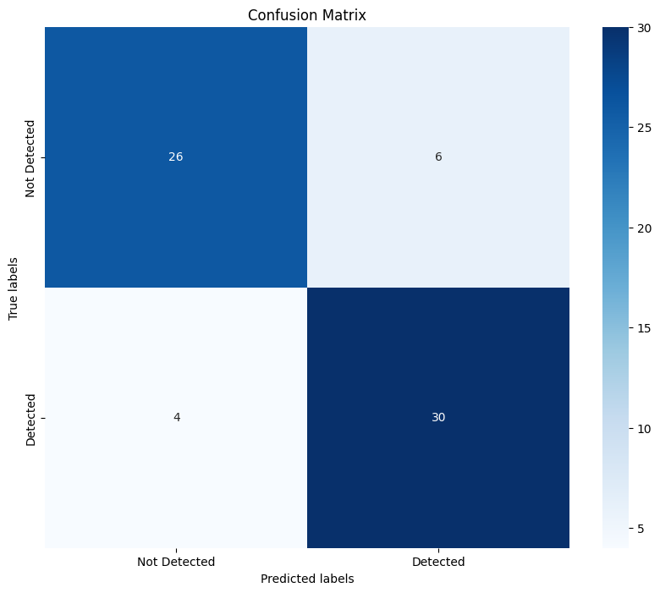
Confusion Matrix
The model has correctly identified 30 instances as 'detected’, which shows it has a good capacity to recognize positive cases.
It has correctly identified 27 instances as 'not detected' , indicating it also reliably recognizes negative cases.
There are 5 instances where the model predicted 'detected' but the true label was 'not detected' . These are false alarms where the model incorrectly identified something as positive.
There are 4 instances where the model predicted 'not detected' but the true label was 'detected' . These are misses where the model failed to detect something it should have.
The confusion matrix shows that the model is more successful at detecting true positives than at avoiding false positives. Similarly, the number of misses (false negatives) is also quite low.

Slide 10

Links
Notebook: https://github.com/rubelbinu/CSCN8010-Labs/blob/main/mini-project-Final.ipynb
HTMl: https://rubelbinu.github.io/CSCN8010-Labs/mini-project-Final.html
http://localhost:8513/

Slide 11

Thank you

